Slide 1
Smart road
Darkness / Movement Detection

Slide 2
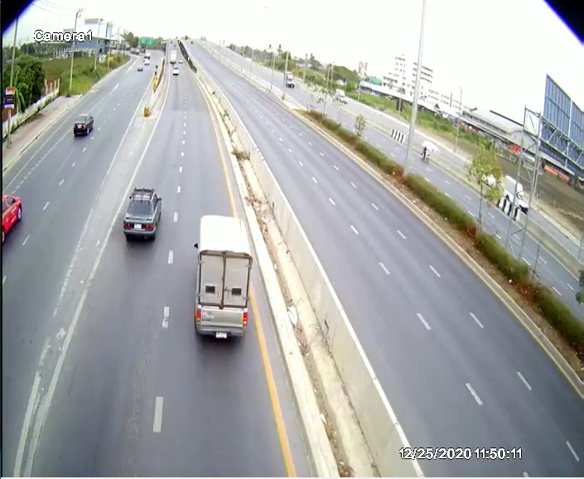
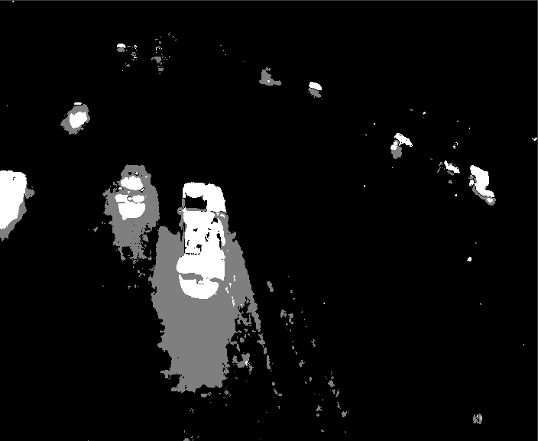
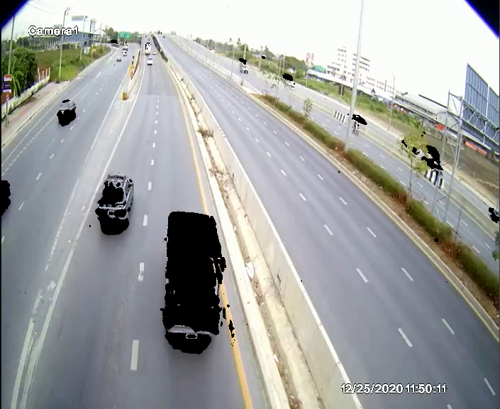
Darkness Detection
OpenCV: Background subtraction method
Original frame
Background subtraction (MOG2)
Invert and Apply to Original frame

Slide 3
Darkness Detection
Background Intensity = Total intensity (R+G+B) / Total pixels (excluding FG mask)
Threshold:-
Night = 260-345
Morning = 400+
Day = 400-500+

Slide 4
Darkness Detection

Slide 5
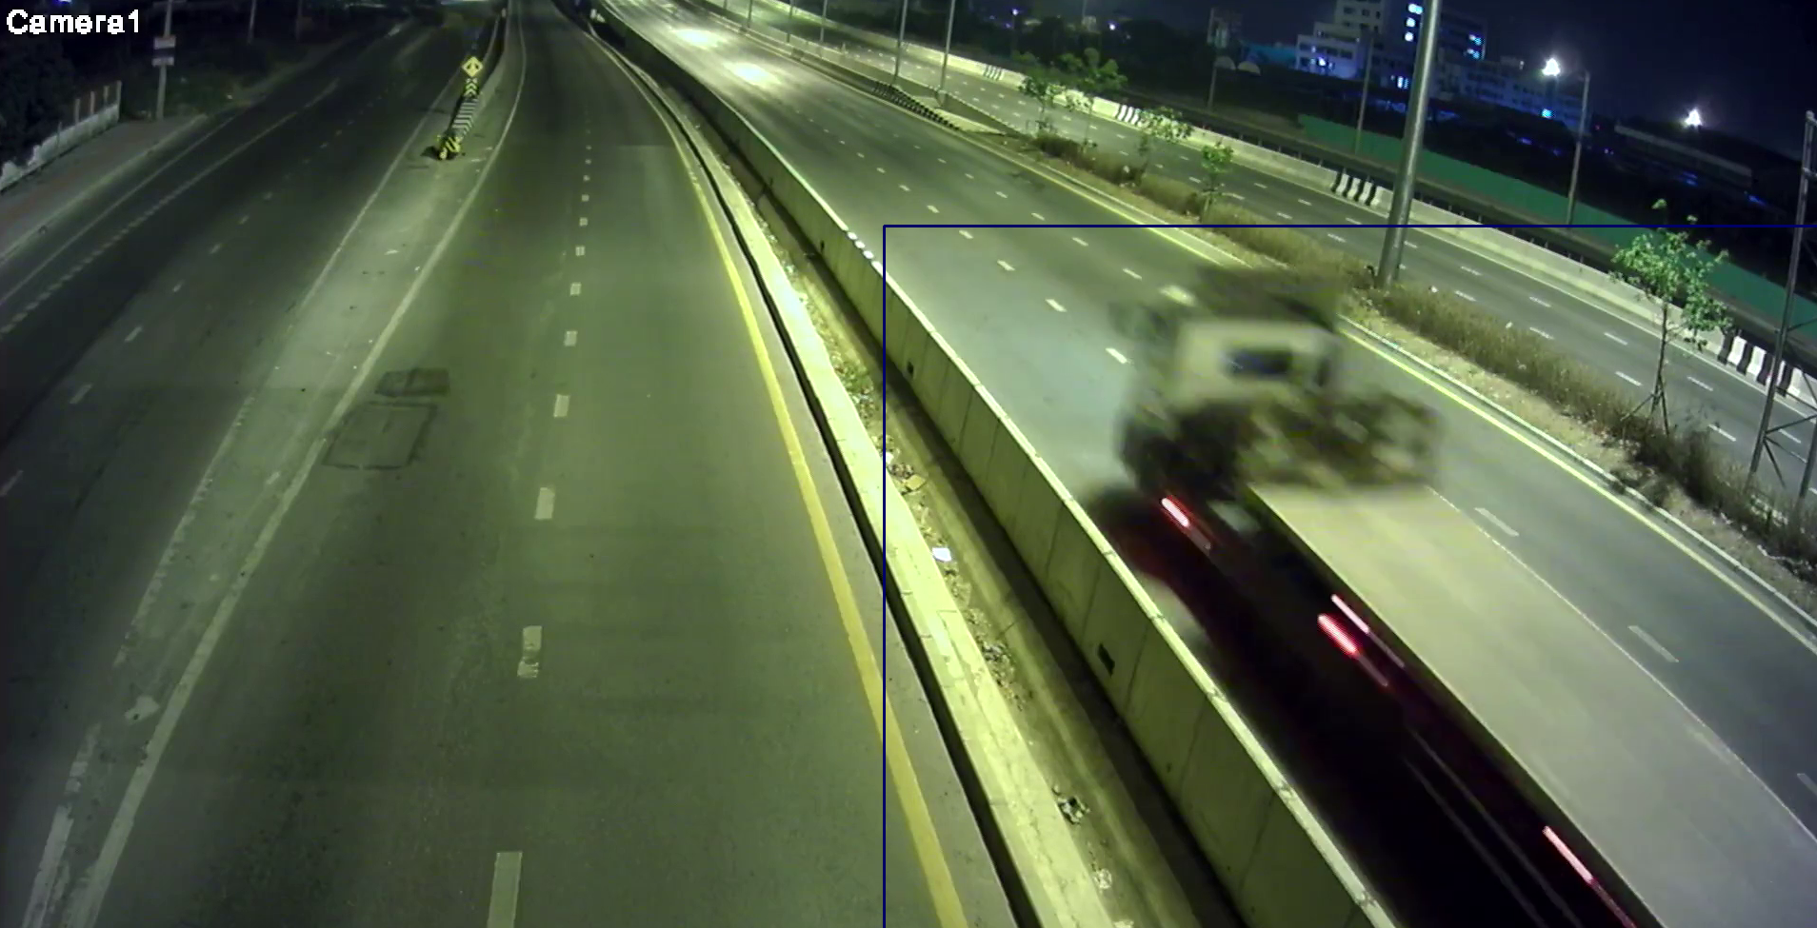
Movement Detection
Methods
Pixel counts
Contour => Bounding box => Size
Contour => Bounding box => Centroid => Movement
FG Mask

Slide 6
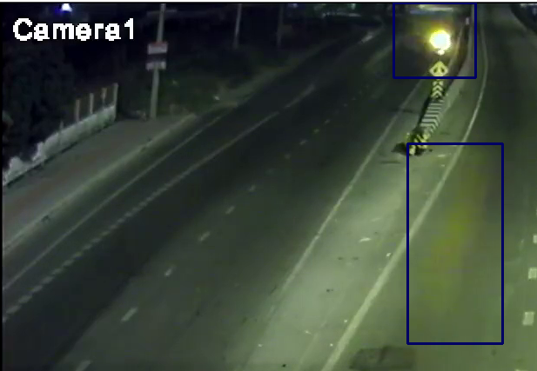
Movement Detection (Problems)
Traffic Light & Reflection
Web + Rain
Web
Web + Bugs

Slide 7
Movement Detection
Proposed Algorithm
Background subtraction => FG Mask
Contour => Bounding box => Area threshold
Bounding box Intersection (ID) => Centroid
Centroid movement
Object Distance threshold / Direction

